Slide 1
Citrix Cloud Services
Apps
Network
Data
Colloque Informatique Santé 2018
Quentin Davoine
Tony Scotti

Slide 2
Agenda
Citrix dans la Santé au Québec
Notre Vision
Citrix Workspace
Citrix Cloud Services
Citrix Workspace App
Questions

Slide 3
Citrix dans la Santé au Québec
Présence dans les 22 CISSS / CIUSSS de la province et dans tous les centres hospitaliers majeurs
Plus de 85,000 utilisateurs (majoritairement Virtual Apps & Desktops)
Méthode de choix pour la livraison de la couche applicative dans plus de la moitié des CISSS / CIUSSS
Mécanisme éprouvé pour la publication des suites Logibec, Medisolution, DSQ, systèmes PACS, Oasis, Cristal-Net, etc.
Supporté par une douzaine de partenaires certifiés répartis dans toutes les régions du Québec

Slide 4
Notre Vision

Slide 5
DIVERSITY OF APPS, DEVICES, AND WORK STYLES
Cloud / Mobile Era
On-Site Data
Multiple Cloud Storage Zones
On-Premise + ERP Apps
SaaS and Mobile Apps
Company-Issued Desktops
PC’s, Laptops, Tablets, Smartphones, Connected Things
Office Workers
Work Anywhere, Contractors, Multi-Generational Workforce
App + Network Traffic
Within Datacenter
Datacenter On-Premise
Branch Operations, and Hybrid-Multi Cloud
USER EXPERIENCE
BUSINESS RISK
IT COMPLEXITY
Notes:
To understand the need for a better strategy, you do need to step back and look at how we got here.
We talk a lot about the different eras of technology - mainframe to PCs - PC to Mobile and so on.
This evolution has greatly expanded the diversity of apps, devices, infrastructure and work styles … creating tremendous flexibility.
We run our infrastructure on-premise, clouds and in hybrid models;
We aggregate app services and let departments procuring their own tools;
Devices are interchangeable; and as we discussed …
Employees, partners, other all want access. anytime. anywhere
In this era, the possibilities are endless but what we now hear most often from customers are the challenges that this causes … because the new items don’t replace the old … they are just added on top. Its estimated 90% of current on-premise applications will still be in use in 5 years.

Slide 6
On-Site Data
Multiple Cloud Storage Zones
On-Premise + ERP Apps
SaaS and Mobile Apps
Company-Issued Desktops
PC’s, Laptops, Tablets, Smartphones, Connected Things
Office Workers
USER EXPERIENCE
BUSINESS RISK
IT COMPLEXITY
Work Anywhere, Contractors, Multi-Generational Workforce
App + Network Traffic
Within Datacenter
Datacenter On-Premise
Branch Operations, and Hybrid-Multi Cloud
Notes:
In general, what we hear is that performance has suffered while risk and complexity are on the rise.
This is because the average large company:
is delivering 100's individual apps, with users forced to navigate multiple environments and performance outcomes
People are feeling overwhelmed by apps, emails, notifications, tasks, and more. This takes up human RAM, increases context switching and reduces output; and
Users are unable to find the data that they are looking for.
Risk has increased as data, device and app security is now distributed into these devices, 3rd parties services, and clouds; and…
Complexity just adds cost and slows us down.
To manage this heterogeneity from a SaaS and Cloud environment, our customers say they've had to invest in a bunch of discrete point solutions that ... well ... add even more complexity.
The industry has created tools in individual categories to address each of these different needs.
This is not only an expensive answer, but you also have to maintain these independent technologies.

Slide 7
COMPLEXITY COSTS
NICHE PRODUCTS = COMPLEXITY
BFSS
Integration
Tools
MDM
Productivity
Endpoint Management
UEM
Mail
Search
LB
VPN
SD-WAN
WAFaaS
EMM
DDoS
MAM
GSLB
ADC + Gateway
WAN
ADCaaS
DNS
IPS
CASB
SWGaaS
Identity & Access Management
SSO
VCC
DLP
SSL
SDWANaaS
UEBA
NGFW
NTA
App-Ops
App Delivery
RBAC
Application Delivery Networks
Cyber Security & Threat Detection
VDI
$800
PER USER PER YEAR
Notes:
Many of these are powerful individual technologies, solving real business problems
But, too often they’re used in a very overlapping manner, not in a cohesive strategy.
This is complex and this is expensive.

Slide 8
NEW CHALLENGES
COMPLEXITY COSTS
$800
PER USER PER YEAR
Notes:
We did some digging into what it costs to license all these disparate point products -- and the typical company spends about $800 to $1000 per user per year … or more.
And, that doesn't even count all the cost of hiring the skills needed to integrate and manage these solutions.
What’s most scary is cost is in ADDITION to what they are already spending to maintain a traditional IT model. That’s a lot of money to spend on declining productivity.
And there’s nothing in the external trends that look to be changing anytime soon. In fact, we’re likely to accelerate from here.

Slide 9
On-premises apps & data
POWERING A BETTER WAY TO WORK
Cloud providers
SaaS & mobile apps
Notes:
At Citrix, we put PEOPLE and SECURITY at the center of everything we do.
To make this work …you need a workspace that is context aware and intelligent enough to offer up the right access, the right insight, and the right performance to get the job done.
So let me tell you where we are focused.

Slide 10
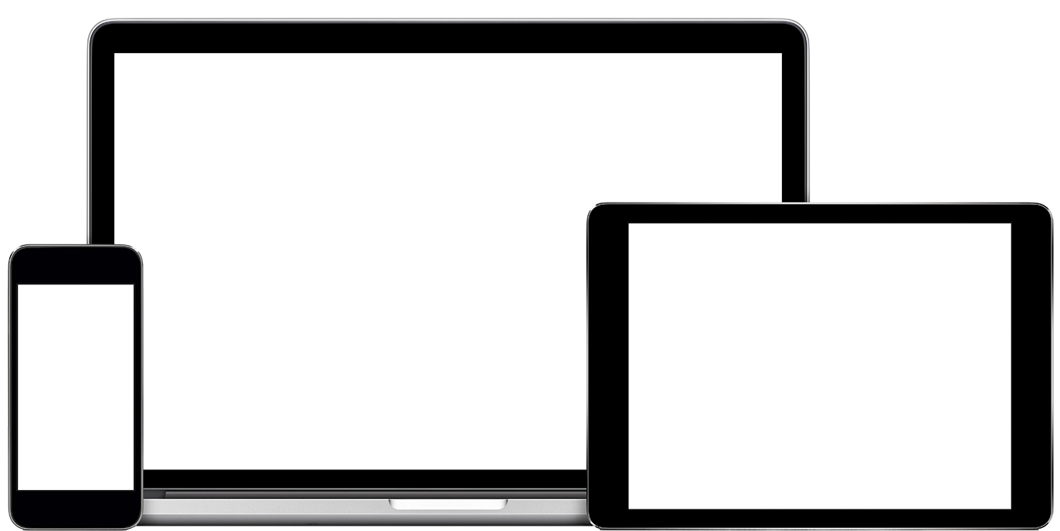
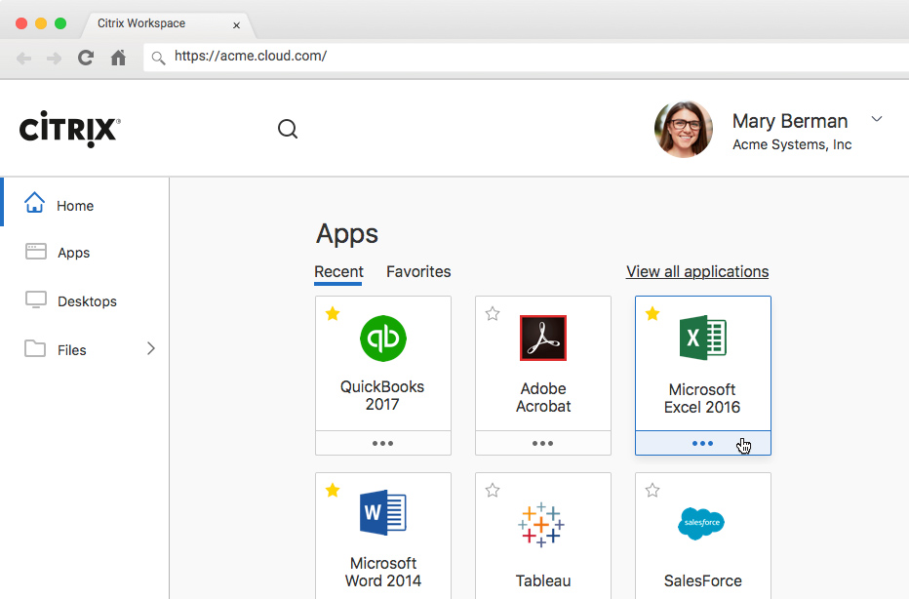
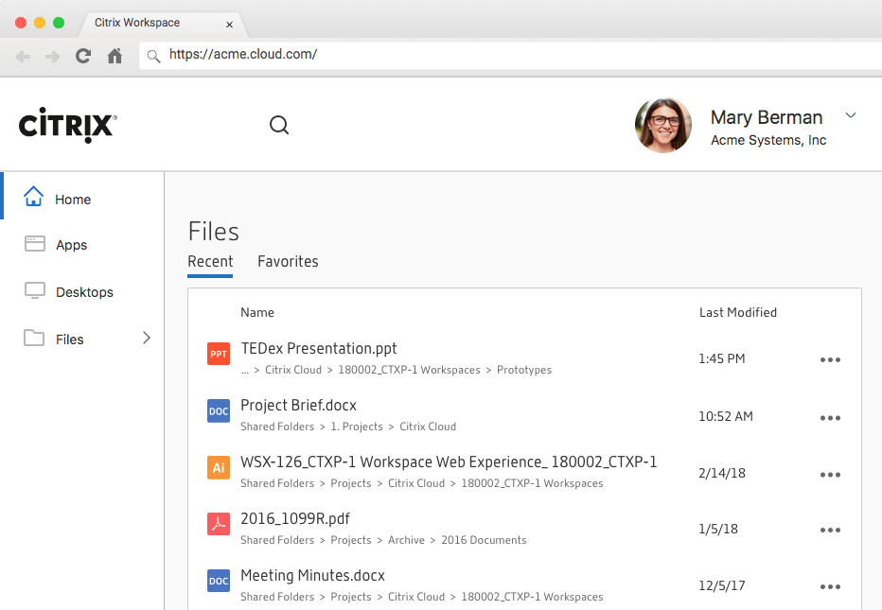
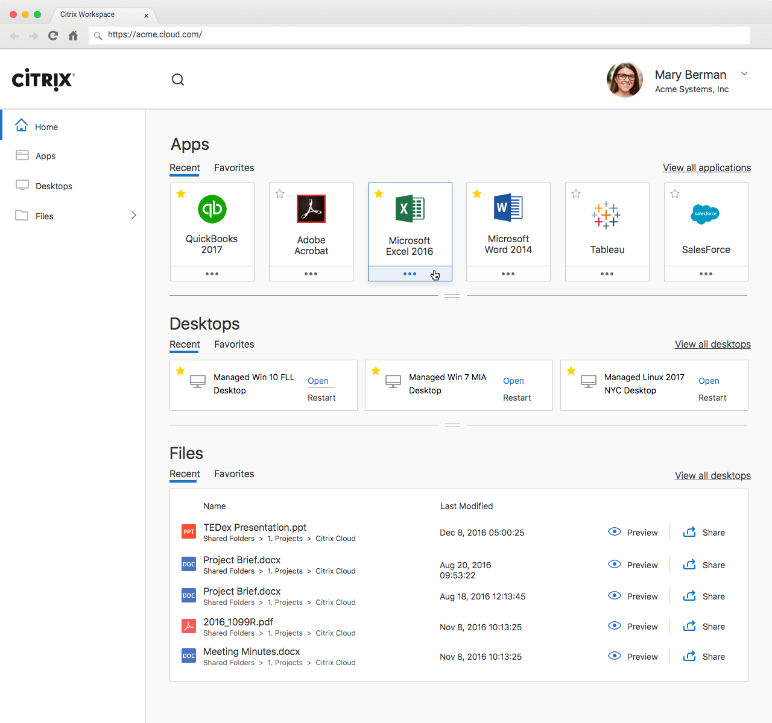
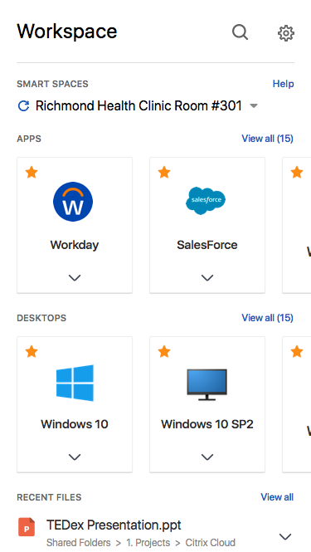
WORKSPACE
APPS
CONTENT
DEVICES
SaaS / Mobile / Windows / Virtual
On-prem / Cloud
PC / Smartphone / Tablet / IoT
ANALYTICS
User / Content / App / Network
SECURE DIGITAL PERIMETER
Notes:
Think about a holistic workspace strategy … it needs to include specific elements:
Secure delivery of applications of all types – from SaaS to mobile to those that are virtualized from the datacenter;
Content delivered in an intelligent, integrated manner – whether it resides on prem or the cloud;
Universal management across endpoints – with a common user interface;
Visibility and control over performance, management and security; and finally …
It needs to have a flexible perimeter in order to embrace the cloud

Slide 11
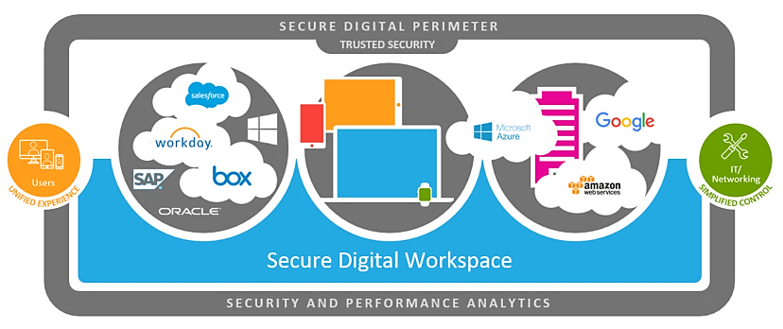
Citrix Workspace
Citrix Virtual Desktops
Formerly XenDesktop
Unified Experience, Simplified Control
Citrix Virtual Apps
Formerly XenApp
Citrix Endpoint Management
Formerly XenMobile
Citrix Content Collaboration
Formerly ShareFile
Citrix Gateway
Formerly NetScaler Unified Gateway
Secure your digital business - safeguard your apps and data
Maintain productivity in an increasingly mobile workstyle
Increase efficiency and lower costs with a cloud strategy
Create smart workspaces with Citrix Workspace IoT
Citrix SD-WAN
Formerly NetScaler SD-WAN
Citrix Analytics
Notes:
TONY

Slide 12
Citrix Virtual Apps and Desktops
Formerly XenApp and XenDesktop
Delivery Controller
One unified architecture for apps & desktops
Built in monitoring and support tools
One site can support multiple OSes
Quick & simple upgrades to new versions
Hybrid on-premises and multi-cloud support
HDX Plug-n-play– USB, printers, scanners
Next generation Thinwire with Adaptive Display
The only Azure-certified App Layering solution
Delivery Agent
Delivery Agent
Delivery Agent
Delivery Agent
Applications & Desktops
Applications & Desktops
Linux
Windows Server
2016 / 2012R2
Windows 10 / 8.x / 7
Linux
Best User Experience
Context-aware Security
Simpler Management
Any network, device, or application
Robust driverless printing solution
Support for graphics acceleration with Intel, AMD, and NVIDIA
Self-service password reset
SmartAccess & SmartControl for fine-grained context-aware policy controls
Session Recording for compliance and advanced troubleshooting
Integrated SSL VPN solution
Industry-leading application & image management (PVS, MCS, App Layering, plus App-V support)
Innovative RAM, CPU and I/O optimization
Notes:
TONY

Slide 13
Use Cases: Citrix Virtual Apps & Desktops
Centrally deliver graphics-intensive 3D apps
Simplify Windows 10 migration
Accelerate workspace mobility with app layering
Provide compression and graphics acceleration technologies to optimize professional 3D graphics apps (like CAD) over low-bandwidth, high-latency networks.
Deliver new Windows 10 virtual desktops to all users, while streamlining ongoing maintenance and future updates. AppDNA reduces cost and complexity of app management.
Simplify packaging, updating and delivering applications across any hypervisor, cloud, or end user computing platform with 99%+ application compatibility.
Deliver secure Linux virtual apps and desktops
Enable remote workers offline
Virtualize Skype for Business
Give users secure access to mission-critical, specialized Linux desktops from non-Linux devices. Manage both Windows and Linux apps/desktops from a single console.
Citrix DesktopPlayer allows users to run Windows virtual desktops on Windows or Mac devices whether they are online, offline, or over a slow and intermittent network connection.
The HDX RealTime Optimization Pack allows you to publish Skype for Business as a virtualized app or within a virtual desktop—with the same performance as a local installation.

Slide 14
Citrix Endpoint Management
Formerly XenMobile
Containment
MDM
Experience
Unified workspace with SSO
Enterprise-grade email
File Sharing PLUS Content Collaboration
Security
2 levels of data encryption – without device enrollment
microVPN integrated network security
Choice
Deliver any app
Multi-container support
Unique EMA/Intune & O365 integration
Windows 10
iOS
Android Things
CMT
MAM
iOT
Mac
Raspberry Pi
Productivity Apps
If - Than
IDM
Passcode policy
AD changes to user
Jailbroken device
Unmanaged device
Data Roaming
Geo-fencing
App Blacklist
App Whitelist
Lock device
Modify policy set
Block network access
Selective wipe
Full wipe
Revoke
Send notification
Set out of compliance
Compliance Engine
Notes:
TONY

Slide 15
Use Cases: Citrix Endpoint Management
Enhance Microsoft EMS/Intune deployment
Enable shared mobile devices & apps
Securely deliver enterprise apps to users
Augment the security of Microsoft EMS/Intune by setting MDM and MAM policies to trigger automated actions for context-aware and action-oriented security.
The shared devices feature lets, for example, clinicians in hospitals use any nearby device to access apps and data, rather than having to carry around a specific device.
Offer the most complete solution for secure enterprise apps, including email, calendar, contacts, file sync and share, and web.
Secure & manage O365 on mobile devices
Enable BYOD without compromising security
Secure internally developed & vendor apps
Provide protection for corporate apps, as well isolation from personal apps on users’ mobile devices. Selectively wipe corporate apps without impacting personal device settings
Combined policies, procedures, and technologies protect customers’ corporate data regardless of where the it is accessed or resides.
The Citrix MDX toolkit is a simple and powerful SDK that makes any mobile application secure with a single line of code, providing features like data encryption and micro-VPN.

Slide 16
Citrix Content Collaboration
Formerly ShareFile
CONTROL PLANE IN
CITRIX CLOUD
Access, share and sync files from any device
Access data residing in existing network shares, SharePoint, & other data sources
Offline access and editing
Built-in mobile editor, rich content editing
Document feedback & approval workflows
Integrated with Outlook
UX
Online user experience
Reporting
Sharefile.com
Sharefile.eu
Delivery Agent
Customer-Managed Private Cloud Storage Options
Azure
Amazon AWS
Any S3-compatible service
Google Cloud Platform
Data
On-premises or
Private cloud
Increase workspace efficiency with collaboration & workflows
Access content from any source, on-premises or in the cloud
Protect intellectual property, govern & audit access
Rich web, desktop, mobile clients
Optimized for virtual desktops
Feedback, approvals, forms, signatures, workflow automation
Data Source Choice (Connectors)
Hybrid storage (StorageZones)
Citrix-provided or BYO
Citrix Analytics
Context-aware security (DLP)
Information protection (IRM)
Fit-for-purpose security settings
Notes:
TONY

Slide 17
Use Cases: Citrix Content Collaboration
Connect multiple storage platforms
OneDrive in Virtual Desktops
Large File Sharing
Avoid file-size restrictions when sending large files like videos, photos, accounting files, CAD drawings, etc. Outlook integration automatically converts large files to link.
You can use StorageZone Connectors to combine SharePoint, OneDrive, network drives, and personal cloud-sharing sites, allowing access of all files from one secure place
Drive Mapper allows for policy-controlled, on-demand access to files and folders on Citrix Virtual App and Desktops farms, with real-time access
GDPR Compliance
Share files securely outside of your company
Execute simple workflows and electronic signatures
Personally identifiable information (PII) can be discovered & removed by the account owner. All data is encrypted at rest and can be protected in transit using Information Rights Management (IRM)
Unlike OneDrive, Citrix allows you to share and request files of all sizes via links or email, with expirations, watermarks, sign-in requirements, and more.
Request feedback from others and get file curation & approvals out of your inbox. Easily sign documents or request signatures from others. Final copies achieved.

Slide 18
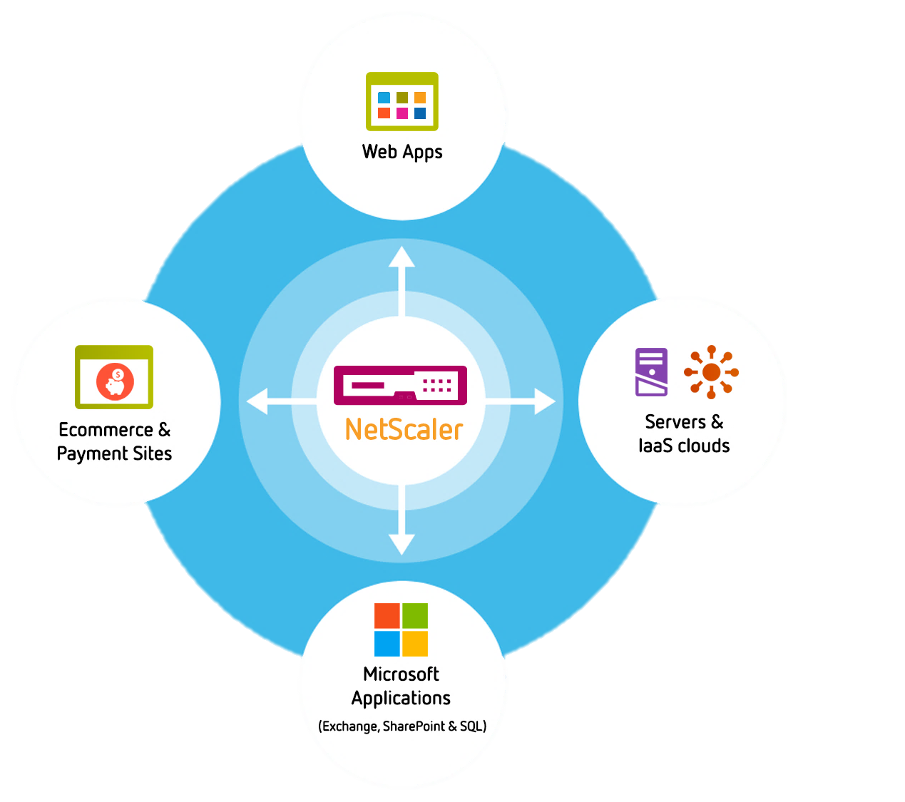
Citrix ADC (VPX)
Formerly NetScaler ADC
CONTROL PLANE IN
CITRIX CLOUD
Access services and apps up to 5x faster, using less bandwidth
Increase availability with L4-L7 Load Balancing
Block up to 99.7% of web app firewall attacks
Geographical failover for disaster recovery
Meet PCI DSS compliance regulations
Ensure 100% uptime of mission-critical business apps
Enable and connect hybrid clouds
Create a secure, contiguous network with Layer 2 bridge
Online user experience
Reporting
Delivery Agent
DDoS Protection
Federated Identity
Application Firewall
SSL Proxy
DNS Proxy
AAA Proxy
Notes:
TONY

Slide 19
Use Cases: Citrix ADC
Boost web application performance
Bolster security without recoding web apps
Improve desktop and application delivery
Accelerate transaction times
Content switching
Compress network traffic
Cache data packets
Web app firewall protects apps from DDoS, SQL injection, XSS, and SSL attacks
Provide PCI DSS compliance to web apps, ecommerce, and payment systems
Single URL access to hosted apps, desktops, & services
Secure, granular policy-driven access control
High availability & monitoring
Enable and connect hybrid cloud
Transition to app-driven, software-defined network
Consolidate legacy load balancers
Seamless connect networks with L2 bridge for one contiguous network
Single console for monitoring, troubleshooting, and analytics
Unifies L4-7 network services into an application control layer, and can make L2-3 architectures completely app-driven
Manage up to 115 independently run Citrix ADC instances on a single appliance

Slide 20
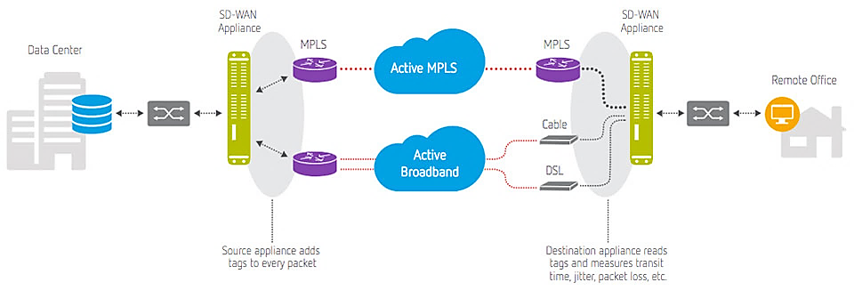
Citrix SD-WAN
MCN
Remote
Formerly NetScaler SD-WAN
CONTROL PLANE IN
CITRIX CLOUD
Criteria | Citrix SD-WAN | Others
Path Assignment | By packet | By connection
Adaptation Time | Milliseconds | Seconds
Adaptation Basis | Uni-directional | Round trip
Application Optimization | Comprehensive & integrated | External with added complexity
Visibility | Deep ICA visibility and broad enterprise apps | No ICA visibility / need for external visibility tools
Firewall | Built-in | External
Provisioning | Zero Touch Deployment | Manual provisioning
Online user experience
Reporting
Delivery Agent
Source appliance adds tags to every packet
Destination appliance reads tags and measures transit time, jitter, packet loss, etc.
Logically bonds multiple, distinct WAN connections into one virtual link
Encrypt paths between devices to provide end-to-end security
Send packets based upon application priority, link performance, and business policies
Most flexible, scalable software-based solution – up to 2500 sites
Notes:
TONY

Slide 21
Use Cases: Citrix SD-WAN
Improve virtualized application user experience
Stop frequent disruptions
Avoid MPLS Contract Renewal
24/7 always-on branch eliminates application interruption
Automatic lossless failover, primary access IP addresses remain unchanged
Bond multiple WAN links to offer expanded WAN capacity that dynamically adapts to network conditions
Reduce bandwidth demand for video content at branch offices
Save up 80% of the cost of traditional MPLS expansion
Use lower cost broadband in place, or integrate mobile and satellite services into an existing MPLS network
Simplify branch infrastructure
Improve VoIP performance
Increase branch security
Firewall allows security policies to be centrally defined by application or application element
Zone support plus segmented data provides rich toolset for separating and limiting traffic
Consolidate network services by combining SD-WAN, Routing, and WAN optimization
Granular control settings allow you to set which categories or even individual apps will receive the highest, real-time Quality of service settings.

Slide 22
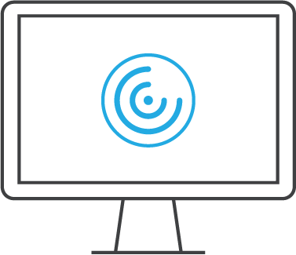
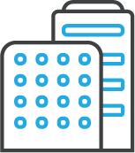
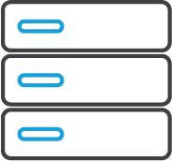
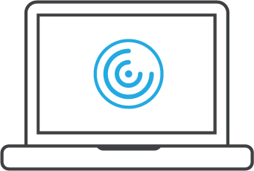
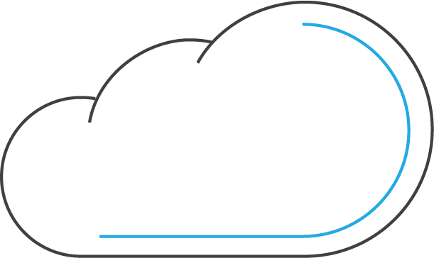
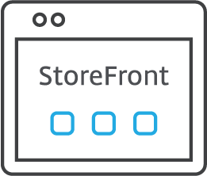
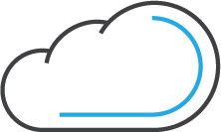
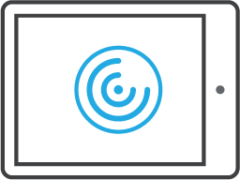
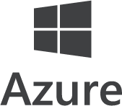
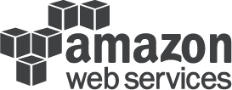
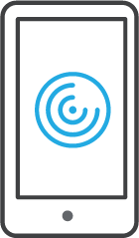
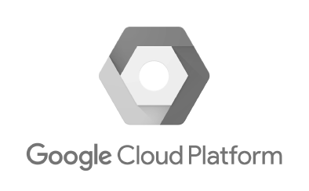
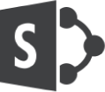
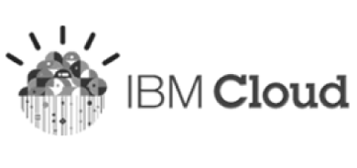
Citrix technology summary
Network
Delivery Controllers
Apps & Data
Resource Location
Virtual Desktops
Desktops
Windows Apps
On-premises
Virtual Applications
Citrix SD-WAN
Secure Browser
Hybrid Cloud
Enterprise Mobility Management
SaaS & Web Apps
Mobile Apps
Cloud (Public or Private)
File Sync and Sharing
Data
Service Management
Monitoring
Analytics
Automation
Provisioning
Notes:
TONY Each piece of the Citrix Workspace individually plays a strong role in delivering a robust security posture. The value of Citrix Workspace is that the integration of these different pieces together provides the best protection against both insider and external threats. Unlike other solutions in the market, security is adaptive and built-in to the Citrix solution, which makes it easier to deploy and more cost-effective.
Remember the old adage: complexity is the enemy of security

Slide 23
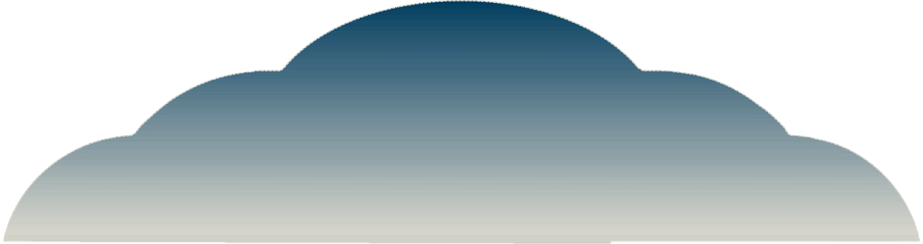
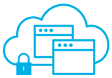
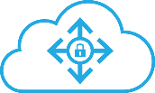
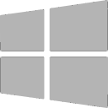
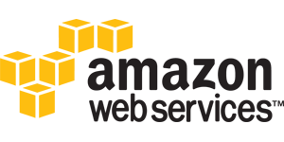
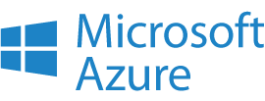
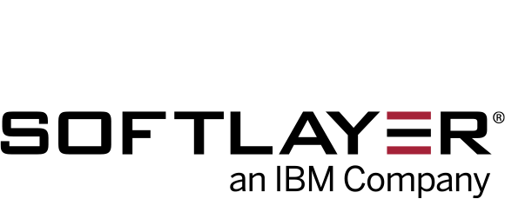
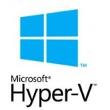
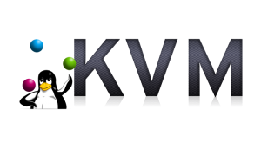
Cloud-based management and delivery for all Citrix workspace technologies
Citrix Cloud: Uniting Delivery of All Citrix Services
Citrix Cloud
Citrix Virtual Apps
& Desktops
Citrix Endpoint Management
Citrix Content
Collaboration
Secure Browser
Smart Tools
Citrix Gateway Service
Citrix Management Analytics
Citrix Virtual
Apps and Desktops
Essentials (Azure)
IoT Automation
Hybrid Cloud | Private Cloud | Any Public Cloud | Any Hypervisor
Notes:
Think of Citrix Cloud as a management plane spanning multiple Citrix products. The core cloud services are operated by Citrix, and contain all of the management functions customers would ordinarily have to install and provision themselves.
The value here is that Citrix has already deployed – and integrated – all of our services into Citrix Cloud. So in many cases, all a customer needs to do is activate, configure and deploy them.
<CLICK> for services like the XenApp and XenDesktop service that have components that require specific deployment locations (such as for virtual desktop machines), Citrix Cloud allows for deployment on ANY cloud or infrastructure. This is VERY different from any of our competitors, who require that management AND apps/data all reside in the same cloud.
And all services are based on our core award-winning products such as XenApp, XenDesktop, XenMobile, ShareFile, NetScaler and AppDNA
With the ability to allow customers to place workloads and data ANYWHERE they want, Citrix Cloud gives them an unparalleled degree of control over security, simplicity and flexibility.

Slide 24
Citrix Cloud: Uniting Delivery of All Citrix Services
Cloud-based management, local resources – less to deploy plus faster, simpler deployment
Citrix Cloud
Studio
Director
License Server
Citrix Cloud (operated by Citrix)
StoreFront/ Receiver for Web
Delivery Controllers
SQL
Cloud Connectors
Customer/Partner Managed
Citrix Gateway
Hypervisors
Active Directory
Server VDAs
Desktop VDAs
Server VDAs
Server VDAs
Server VDAs
Server VDAs
Resource Location(s)
Notes:
TONY With Citrix Cloud, a number of services are now available as always-on cloud services. That means customers no longer need to install – or even properly size/scale them.
Citrix ensures that the cloud services are always up-to-date. No upgrades or patching is ever needed. And, as a customer implementation grows or shrinks, the Citrix Cloud services scale themselves.
What is still the customer’s responsibility are the VDA’s and gateway. However, customers have the option of deploying these services wherever they want… on-premises, in public clouds, or across multiple locations (these are called “Resource Locations”). Deploying the VDAs and Resource Locations is far simpler than deploying the other services.
Resource Locations are securely connected to Citrix Cloud with a Cloud Connector, a Stateless Machine that brokers commands between the Deliver Controllers, and the services in each resource location.
Cloud Connector Services Architecture:
Provisioning for managing VM workload on hypervisors
Proxy for VDA registration and communication
Identity to support domain discovery and access
Authentication to enable user logon and app launch

Slide 25
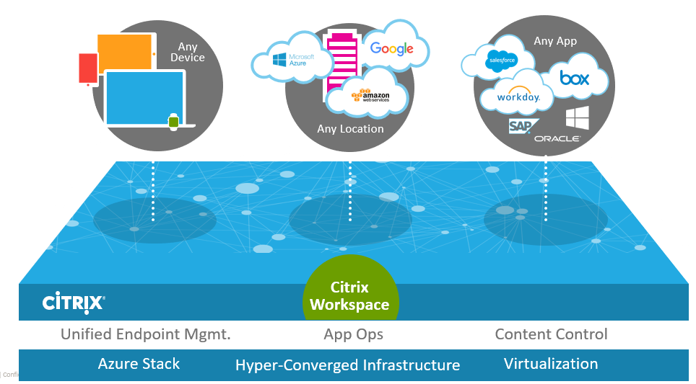
Citrix Cloud Benefits
Faster to deploy Citrix technologies
Integrated Citrix environments
Inherently multi-site
No more upgrades - receive new functionality automatically
Less technical expertise required to setup and administer
No need to maintain physical infrastructure
Less up-front investment
Cloud success management

Slide 26
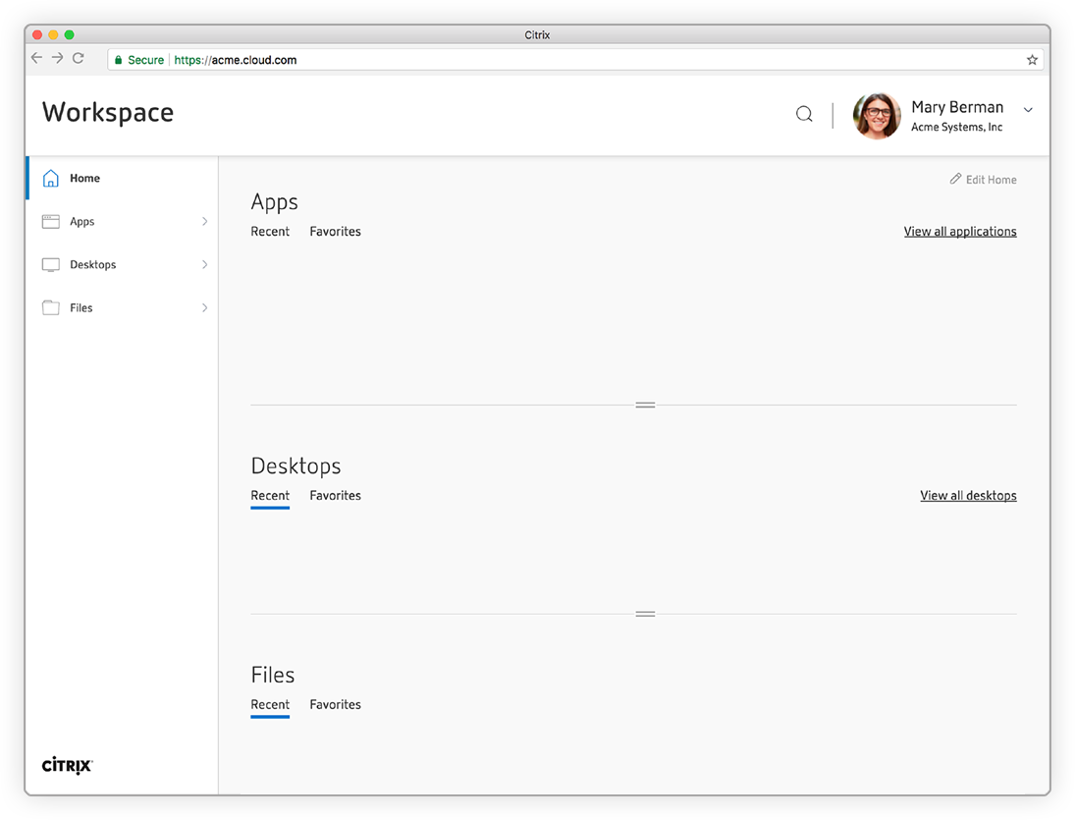
Introducing Citrix Workspace app
Citrix Workspace
Notes:
Instant access to your web, SaaS, Windows, Linux, mobile apps, desktops and files from an easy-to-use, integrated interface makes Citrix Workspace a truly comprehensive digital workspace solution.

Slide 28
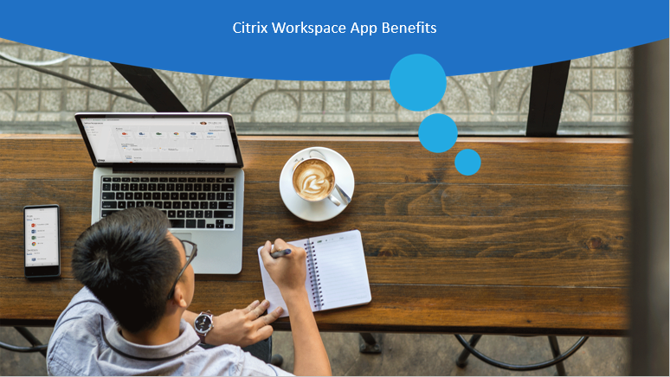
Citrix Workspace App Benefits
Notes:
Welcome to the Citrix Workspace Self-Guided Tour.
This forward-looking indication of plans for products is preliminary and all future release dates are tentative and are subject to change.
The development, release and timing of any features or functionality described for our products remains at our sole discretion and are subject to change without notice or consultation. The information provided is for informational purposes only and is not a commitment, promise or legal obligation to deliver any material, code or functionality and should not be relied upon in making purchasing decisions or incorporated into any contract.

Slide 29
Everything you need—apps, files and desktops—at your fingertips
Notes:
Instant access to your web, SaaS, Windows, Linux, mobile apps, desktops and files from an easy-to-use, integrated interface makes Citrix Workspace a truly comprehensive digital workspace solution.
New Workspace User Interface
Citrix Workspace Premium will give you a completely integrated digital workspace solution that incorporates your Windows, Linux, mobile, SaaS, web apps, desktops and files into one easy to use interface.
All the resources available as part of Workspace Premium are aggregated and delivered on-demand to every user.
To simplify set-up and configuration, the Workspace app UI is delivered as a cloud service making it easy to get started.

Slide 30
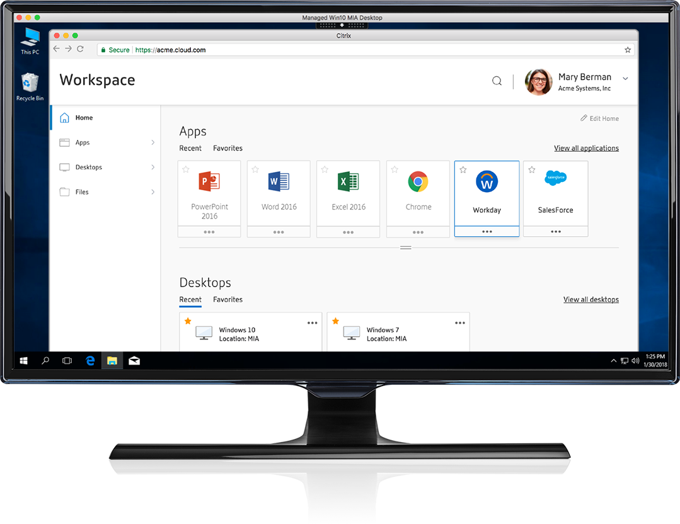
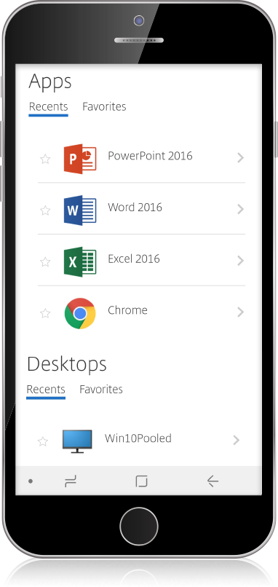
Consistent user experience from desktop to mobile device
Notes:
The simple, consumer-based Citrix Workspace interface is consistent as you move from your desktop to a mobile device. With Citrix Workspace your favorite apps, desktops and files are ready to go with just a click on any device.
Consistent user experience
New Citrix Workspace app delivers a consistent user experience on any device.
User interface automatically adjusts based on form factor and screen size.
Incorporating smart features like search, users can quickly launch an app – web, mobile, SaaS, Windows and Linux – or quickly find a file.
Recent apps are prominently displayed for fast access, while favorite apps are just a click away.

Slide 31
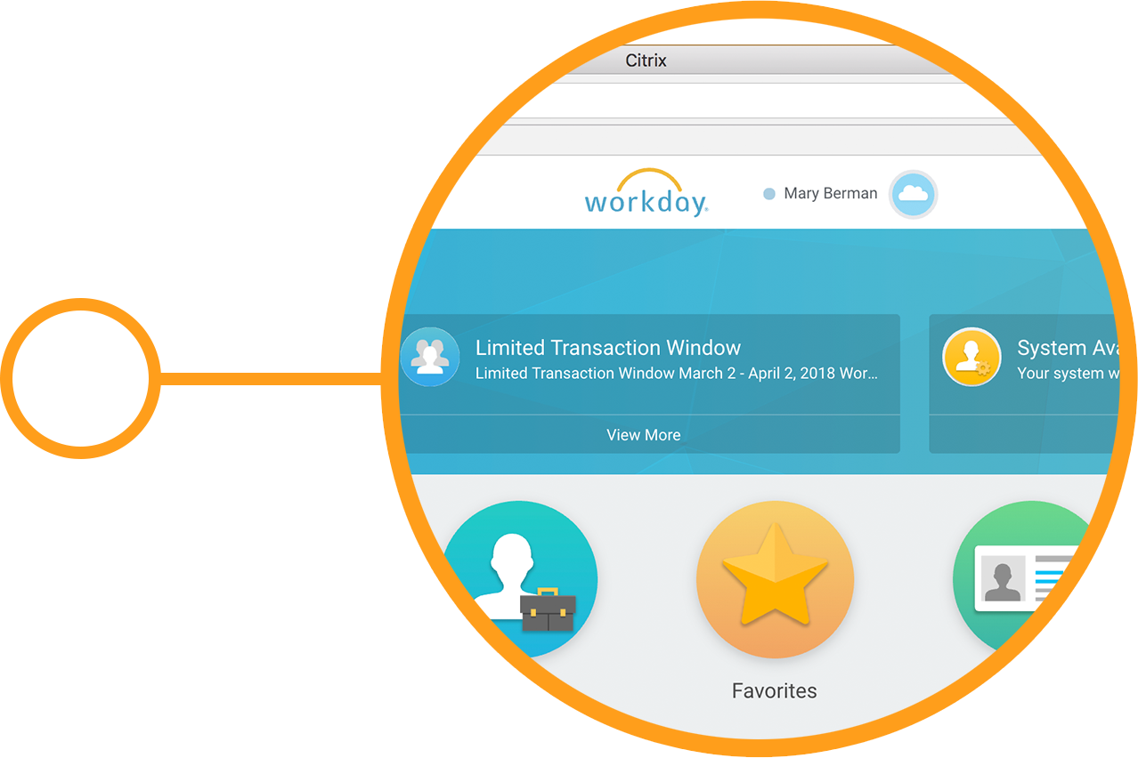
Single Sign-On to any app—Windows, web, mobile & SaaS
Notes:
Frictionless, password-free access to your Windows, web, mobile & SaaS applications, including Office 365, from any device. Citrix Workspace gives you fast-access to the resources you need to stay productive, while ensuring IT can maintain security and control.
Single Sign-On (SSO) to apps
Citrix Workspace Service includes NetScaler Gateway Service Standard as an easy to use cloud service
Citrix Workspace Service provides SSO to web, virtual and SaaS applications such as Office 365 and Salesforce.
Citrix Workspace Service NetScaler Gateway Standard can be implemented as an IdP or proxy for ADFS and provides SSO to SaaS
Detailed information available in the following blog: https://www.citrix.com/blogs/2018/04/12/citrix-unveils-secure-gateway-service-with-single-sign-on-to-saas-enterprise-vdi-apps/

Slide 32
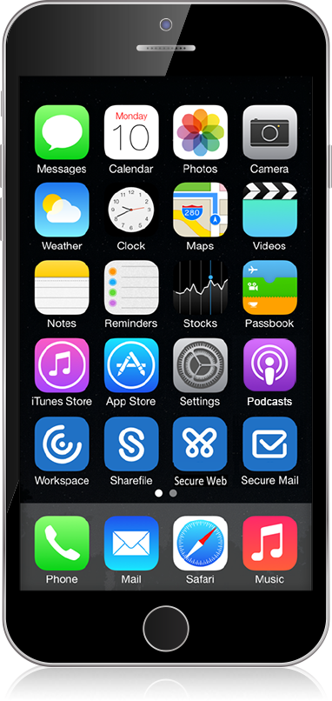
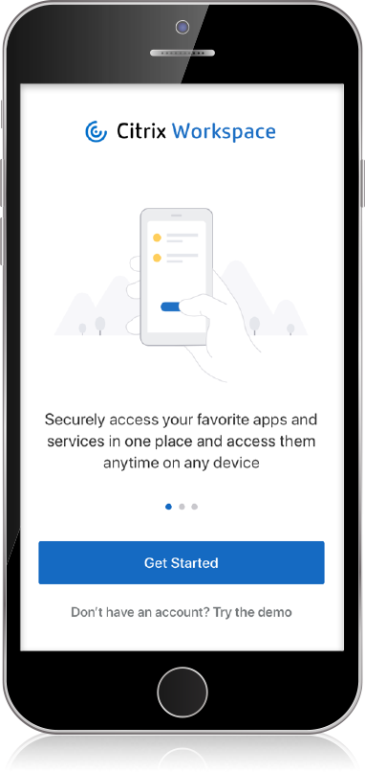
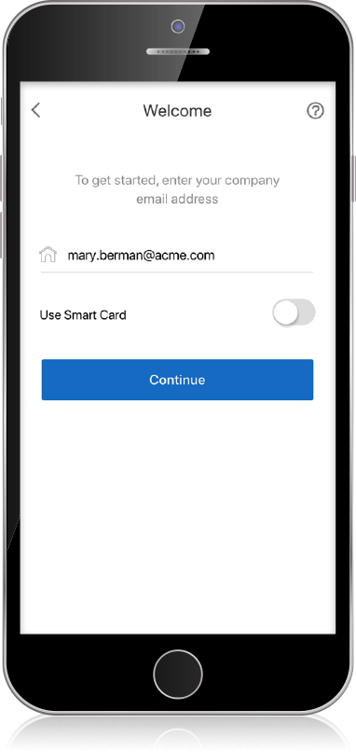
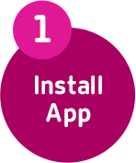
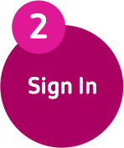
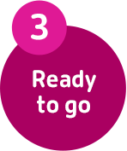
Enrolling a new device is as easy as 1-2-3
Notes:
New employees can enable any device—Windows, Mac, iOS, Android or Linux—to become a Citrix secure digital workspace in a few easy steps.
New user, New device
Onboarding new users with new devices is easier than ever-before
Employees will be able to go to any app store and download Citrix Workspace app
Citrix Workspace app runs on locked-down devices via a web browser
The single client – Citrix Workspace app – will contain everything IT needs to get a new employee up and running with virtual, web, SaaS, mobile apps, desktops and data

Slide 33
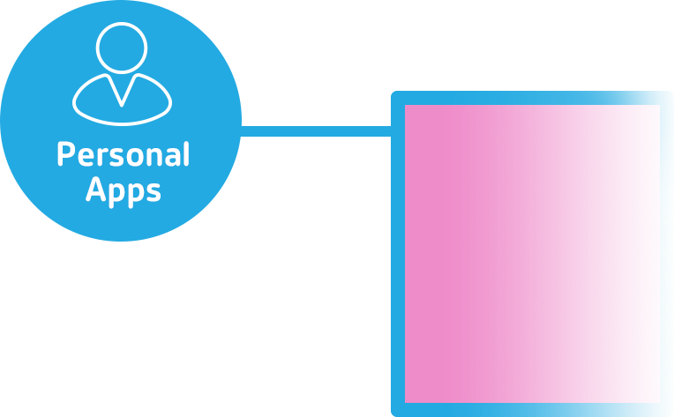
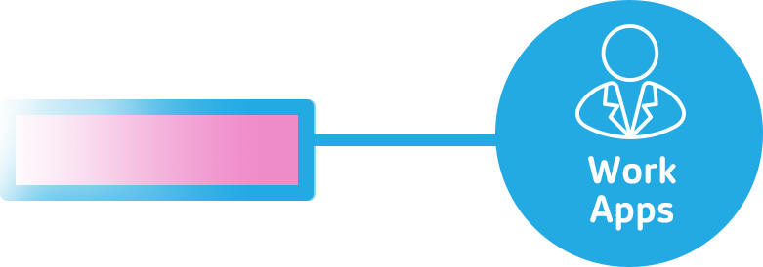
Personal device freedom with IT security & control
Notes:
With Citrix Workspace, your personal apps and work apps can securely coexist on your personal device without compromising the security of company data.
Separate work and personal apps
IT can segment resources between personal and business, giving BYOD users secure access to corporate resources from their personal device
Citrix Workspace app makes it easy for mobile users to access any app
Enhanced, integrated Secure Mail makes it easy for users to easily access their files regardless of where the files are stored

Slide 34
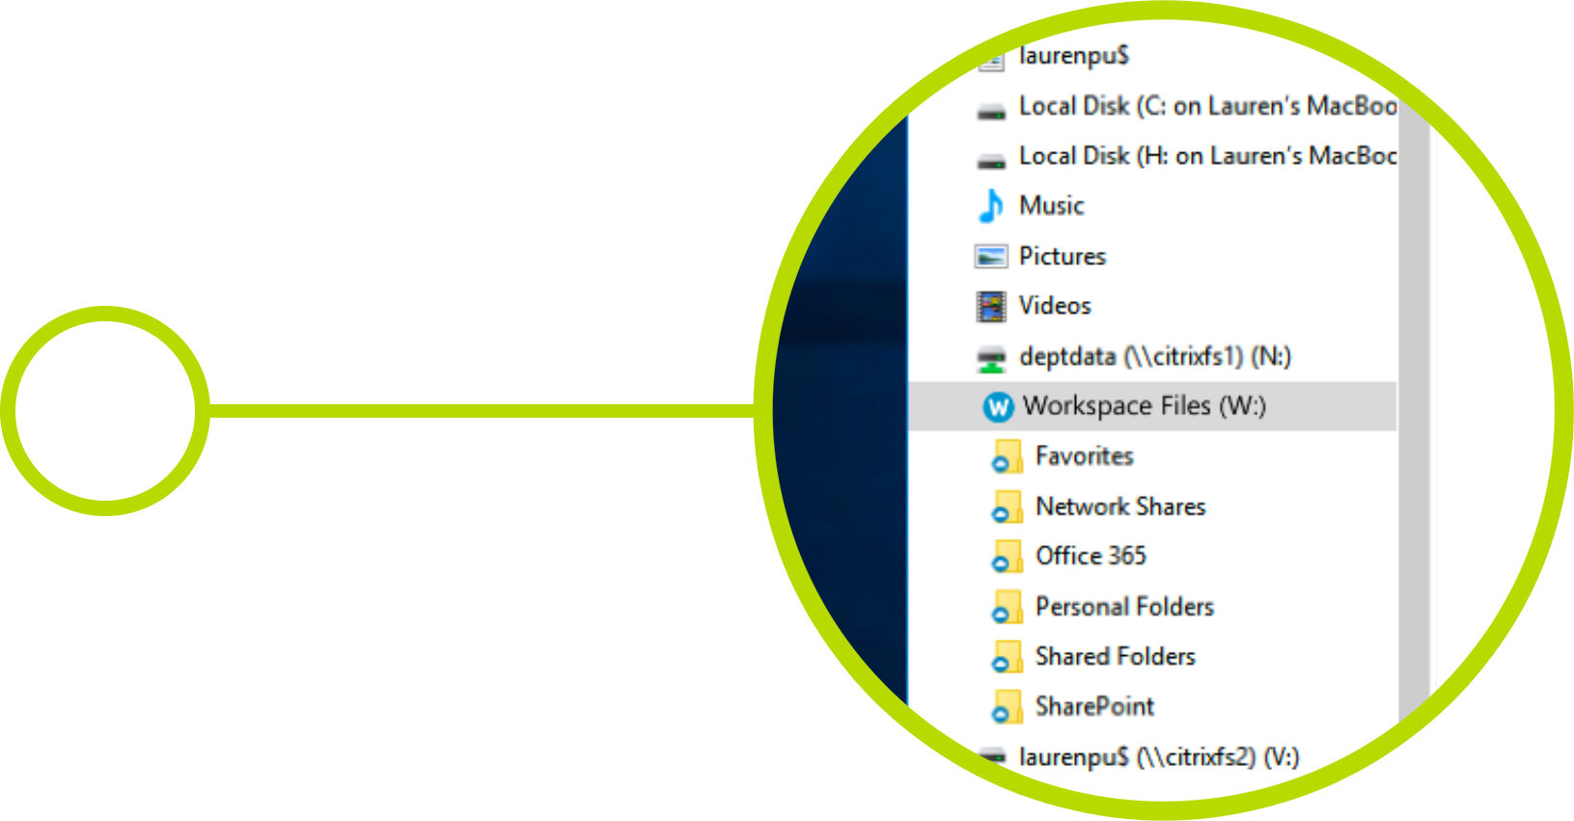
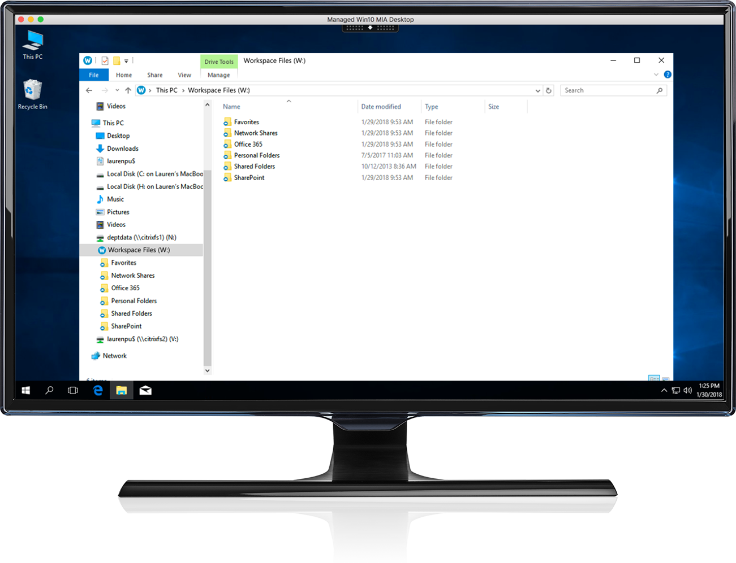
Fast access to all your files
Notes:
Only Citrix Workspace gives you fast access to all of your files—OneDrive for Business, ShareFile, ECM Systems, and other document libraries—for instant access at any time. Centrally stored files are available at your fingertips and dynamically synchronized across devices for instant access.
Fast access to all your files
Citrix Workspace delivers one centralized location for all your files, including OneDrive for Business, ShareFile, ECM Systems, and other document libraries – for instant access at anytime
Citrix virtual apps and desktops will give IT the ability to integrate Citrix Workspace file sync and share capabilities directly within virtual resources

Slide 35
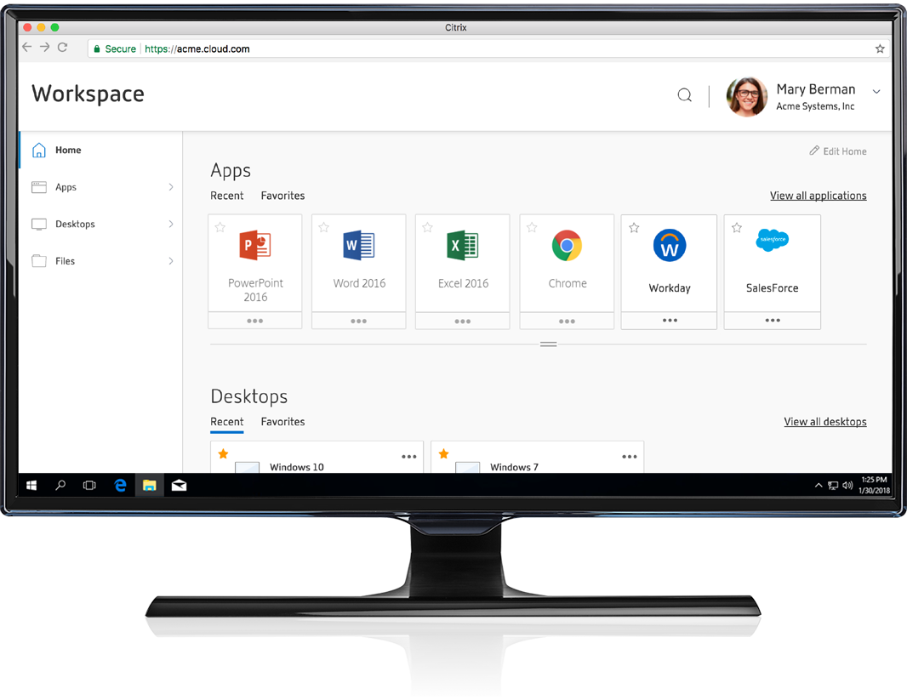
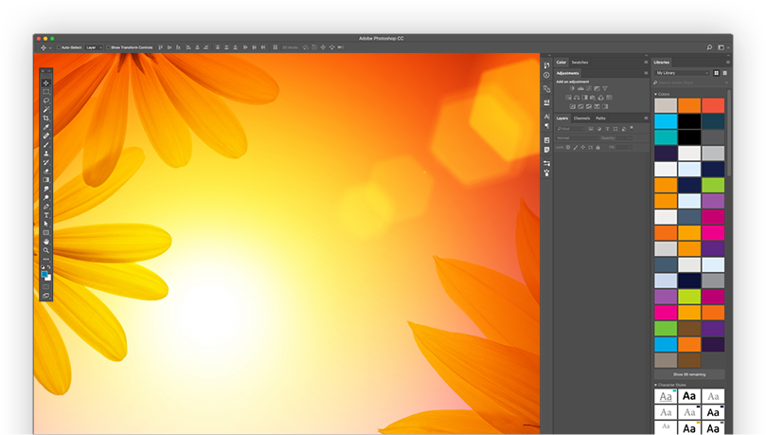
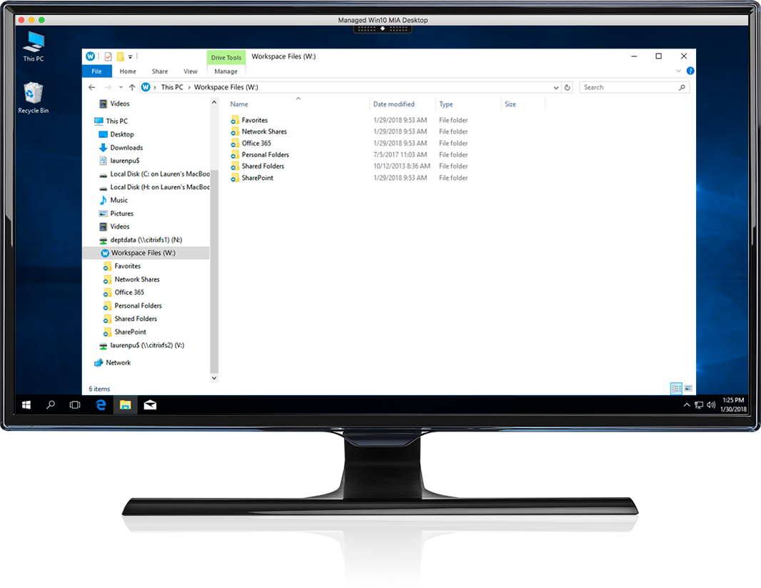
Instantly open files in a virtual app to seamlessly transition between devices
Notes:
Important files seamlessly open in a virtual app making it easy to go from device to device. You can instantly pick up where you left off to make edits on-the-fly or collaborate with the team.
File synchronization across workspace
Integration of files synch and share capabilities throughout the Citrix Workspace makes it easy to collaborate within a virtual desktop and then quickly transition to your mobile device for on-the-go updates
Workspace app will automatically launch an important file within a published application to ensure that the user can remain productive even when the associated application isn’t locally installed

Slide 36
Cast your Citrix Workspace to the nearest display with Citrix workspace hub
Notes:
No more logging in and out of sessions as you move throughout the office, hospital or showroom floor. Citrix Workspace enables you to cast your session to any display connected to a
Citrix workspace hub.
Citrix workspace hub
Citrix workspace hub is a low-cost, high-performance IoT edge device that can instantly turn any monitor and keyboard into a comprehensive digital workspace
Only Citrix Casting via Citrix workspace hub makes it possible for users to securely and seamlessly move virtual app and desktop sessions from a mobile device to a Citrix Ready workspace hub for on-the-go collaboration.
More info available in the following blog: https://www.citrix.com/blogs/2018/02/14/announcing-the-citrix-ready-workspace-hub/

Slide 37
Need an additional Citrix Workspace app or desktop? IT can rapidly provision your new resource with ServiceNow
The development, release and timing of any features or functionality described for our products remains at our sole discretion and are subject to change without notice or consultation. The information provided is for informational purposes only and is not a commitment, promise or legal obligation to deliver any material, code or functionality and should not be relied upon in making purchasing decisions or incorporated into any contract.
Notes:
Citrix Workspace integration with ServiceNow will expedite the handling of your new app or desktop requests. Once your helpdesk ticket enters ServiceNow, your IT admin can automate the provisioning of your new app or desktop to your Citrix Workspace.
Citrix Workspace & ServiceNow
Citrix Workspace will integrate with ServiceNow to expedite user on-boarding and off-boarding
Quickly request Citrix Workspace resources to scale up and down Citrix virtual app and desktop resources directly from ServiceNow service-desk portal
Leverage ServiceNow to track all virtual app and desktop resources for chargeback and showback costing

Slide 38
Control over SaaS apps & content
Notes:
Centralize access to corporate SaaS and web apps for unprecedented visibility and control. All SaaS apps are secured through advanced policies, like watermarking, to prevent data loss.

Slide 39
Protect against risky web browsing
Notes:
Employees need internet access to be productive, but the internet has unforeseen security threats. Citrix Workspace app can intelligently redirect internet browsing tasks to an isolated, cloud-hosted web browser to enhance IT security.

Slide 40
Protected by Citrix Analytics
Notes:
Citrix Workspace app, powered by all the Citrix Workspace services, is protected within a secure digital perimeter. Using machine learning and artificial intelligence to detect anomalous behavior and potential threats, Citrix Analytics can protect users, data and the Citrix Workspace.

Slide 41
Citrix Workspace: unified experience, simplified control
Secure, simplified access and control of apps and data across any device, platform, or cloud
UNIFIED EXPERIENCE
SIMPLIFIED CONTROL
Secure Digital Workspace
IT/ Networking
Users
Notes:
THE CITRIX SECURE DIGITAL WORKSPACE.
Complexity is really hard to tame but it's also where Citrix can help. Really helping organizations deal with the complexity and pull it together, in a way that creates this new software-defined perimeter and also enables the easy access for people wherever they are around the world, whatever device they come in, to give them contextual access to the apps, information and resources they need.
Whether it's a cloud technology coming from one of many clouds, or whether it's traditional on-prem technology, or whether it's mobile technology, they need to access it all in a simple, contextual way, and that is precisely what we do.

Slide 42
People get: unified access, reliable performance
Unified access to all apps and content backed by contextual security & performance.
Any Device
Any App
Any Location
Citrix Workspace
Unified Experience
Contextual Performance
Contextual Access
Notes:
For the end user, for people at work, the most important thing is the unified experience enabling them to access their workspaces. It needs to be familiar and fluid. From the moment they get into the workspace, they need to feel like they have access to everything that they need.

Slide 43
IT gets: simplified on-boarding, management, & control
Flexibility to run workloads anywhere; agility to change as needed
Any Device
Any App
Any Location
Citrix Workspace
Unified Endpoint Mgmt.
App Ops
Content Control
Run Where You Want
Hyper-Converged Infrastructure
Virtualization
Notes:
On one side, IT needs to manage all of those devices and control the policies for access. You need to manage all of the apps, and need to modernize them. We know that app modernization is one of the biggest hurdles that IT organizations face. You also need to have full visibility, and that is the way to turn your company into an intelligent organization.

